Slide 1


Wannadoo
See your city — and each other — anew.
Short walking adventures for couples, generated from where you stand
[Team name] · [Name] · [Name] · [Name]
Notes:
~10 s. Introduce the team and the one-line pitch: Wannadoo turns your city into a short shared adventure for couples.

Slide 2




THE PROBLEM
Date night defaults to dinner and a movie
Ideas go stale
The longer a couple is together, the more their dates repeat.
Planning is a hassle
Busy lives leave no time to research something new, so nothing happens.
Memories scatter
Couples take photos on dates but never collect them anywhere.
Notes:
~25 s. [Placeholder script]
We interviewed seven people in relationships. Everyone defaults to the same dates, and the longer they are together the harder it gets to find something new. Planning takes time nobody has, and the photos they take end up scattered.

Slide 3




OUR SOLUTION
Wannadoo turns your city into a date
A surprise route
Meaningful questions, exciting challenges
Your shared map
A walking loop of 4–6 spots near you, built fresh from where you stand; reroll if you like.
Each stop unlocks a question you both answer or a challenge to complete, starting light and getting more personal.
A couple photo at every stop lands on a map of the places you have explored together.
Notes:
~25 s. [Placeholder script]
Wannadoo builds a short walking loop from wherever you are. Each stop unlocks a conversation prompt you answer together, and a photo that lands on your shared map. No planning, something new every time, and a record of where you have been.

Slide 4

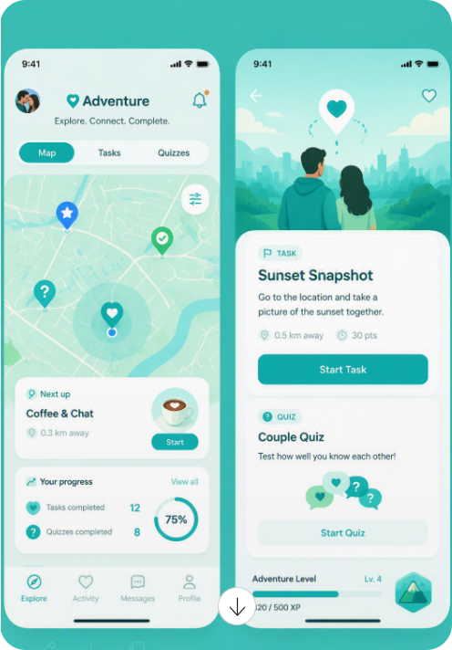




LIVE DEMO
One evening, one loop
1 Link your partner
Scan their code to share one adventure
2 Choose a Route
A fresh loop from where you stand
3 Arrive and talk
Each stop unlocks a prompt for you both
4 Snap and collect
Your photo lights up the pin on your map
Notes:
~60 s. Keep this slide up as the backdrop and switch to the live app.
1. Pick Daniel, simulate scanning Emma's code.
2. Choose Surprise Route; show the generated loop on the map. Mention reroll.
3. Start the route, simulate arrival at stop 1, read the prompt aloud.
4. Take a photo; show the pin light up and the next stop unlock.
Fallback if the route services rate-limit: use the curated "Rediscover Riga" trail.

Slide 5


VALIDATION · USERS
What couples told us
INTERVIEWS
LESSONS LEARNED
PIVOTS
7
interviews with people in relationships
Most have never paid for a scavenger hunt
A generic scavenger hunt
An app built for couples
“The more dates, the more they repeat.”
“We take photos but never really collect them.”
“An external nudge wouldn’t hurt.”
None has ever paid for date ideas
New couples have ideas to spare; established couples run dry
Whimsical games
Activities that deepen connection
Everyone craves deeper connection and intimacy
Notes:
~25 s. [Placeholder script]
We interviewed seven people, from students to a 70-year-old in a new relationship. Most had never paid for a scavenger hunt, and none had ever paid for date ideas. New couples have plenty of ideas; established couples run dry. And everyone wants deeper connection.
So we stopped building a scavenger hunt and built an app for couples, with activities that bring them closer rather than games for their own sake.

Slide 6
VALIDATION · MARKET
Where the market leaves a gap
COMPETITORS
LESSONS LEARNED
PIVOTS
Let’s Roam
3.3★
Scavenger-hunt and travel apps crowd the market
Road Games, a scavenger hunt app
3,000+ cities, $11 per player per hunt. Reviews cite crashes and no photo download.
Wannadoo: outdoor dates made for couples
Couples apps abound, but they keep couples indoors
Crazy Dash, 3Quest
US
A generic hunt with a date add-on; US and Canada only, ~$22 per person.
THE GAP
Fun for an afternoon
Nobody offers outdoor activities made for couples
Insight that builds lasting connection
Paired, Adeux
Home
Couples apps with daily questions and quizzes; they stay on the sofa.
Notes:
~25 s. [Placeholder script]
The market is full of scavenger-hunt and travel apps: Let's Roam is the biggest, in 3,000+ cities, yet rates 3.3 on Trustpilot. Couples apps like Paired keep people on the sofa. Nobody offers outdoor activities made for couples.
That gap turned Road Games, one more scavenger hunt, into Wannadoo: outdoor dates for couples, with activities that leave them knowing each other better.

Slide 7


THE VERDICT
Is Wannadoo worth pursuing?
OUR ANSWER
[Yes / No / Yes, if …]
For
Against
A real, repeated pain for established couples
A clear gap: outdoor activities made for couples
A working prototype in Riga
Nobody pays for date ideas today
Retention is untested
Let’s Roam could add a couples mode
Next step: [e.g. pilot with 10 Riga couples]
Notes:
~15 s. Give the verdict and the next step. [Team to decide both before presenting.]
Close with the tagline: See your city — and each other — anew.

